Slide 1
E-Commerce-Analysis and Linear Regression
Yuvaraj Pandian

Slide 2
E-Commerce
Electronic commerce (e-commerce) is the exchange of goods and services over the internet. It can include buying and selling physical goods, digital products, and services. E-commerce can take place within a company's smartphone app, on a social media platform, or in an online marketplace.

Slide 3
Agenda
Overview of Dataset
Key Findings
Insights and Analysis
Linear Regression Modeling
Conclusion

Slide 4
Overview of Dataset
Total Entries: 30,000
Columns: 17
Features: Product attributes such as category, brand, price, availability, and customer ratings.

Slide 5
Key Findings
Popular Product Categories:
Clothing and Accessories
Footwear
Bags, Wallets & Belts
Toys
Top Brands:
ARBO
Pu
(Empty string - requires further investigation)
Out-of-Stock Products:
Approximately 5.81% of products are out of stock.

Slide 6
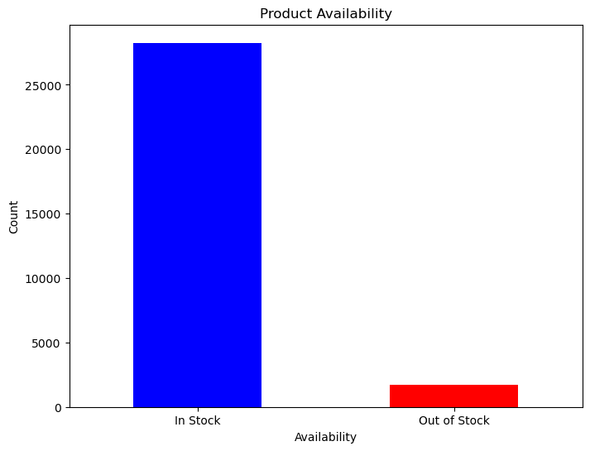
It suggests that the majority of products in the dataset are available in stock, with only a small proportion being out of stock. This can be interpreted as a positive indicator of product availability for potential customers and can also be beneficial for business operations, as higher availability often leads to increased sales and customer satisfaction

Slide 7
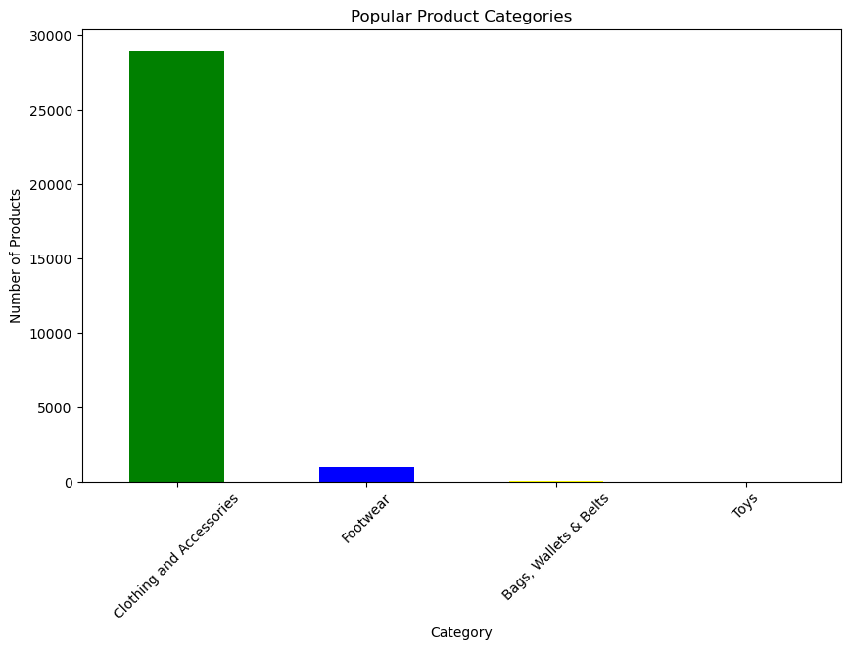
The analysis provides insights into the popularity of different product categories, with Clothing and Accessories being the most popular, followed by Footwear, Bags, Wallets & Belts, and Toys. This information can be valuable for understanding consumer preferences and making informed decisions related to product stocking, marketing strategies, and inventory management.

Slide 8
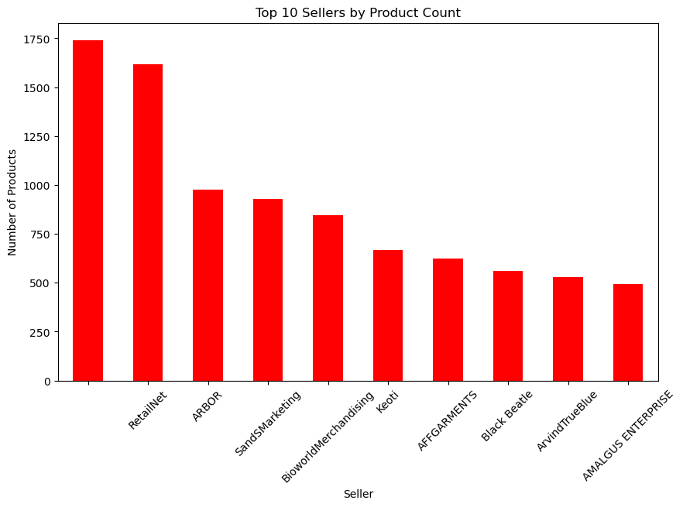
The bar plot visualizes the performance of the top 10 sellers in terms of the number of products each seller offers. Each bar represents a seller, and the height of the bar indicates the number of products offered by that seller. Sellers are ranked based on the count of products they offer, with the top 10 sellers being displayed.

Slide 9
3. Insights and Analysis
Brand Performance:
ARBO and Pu are the top brands based on product count.
Average selling price and rating analysis reveals brand reputation.
Price Distribution:
Comparison of actual prices between brands 'York' and 'Oka'.
'Oka' may have a broader market presence based on price distribution.
Customer Sentiment:
Sentiment analysis of product descriptions indicates predominantly positive sentiments

Slide 10
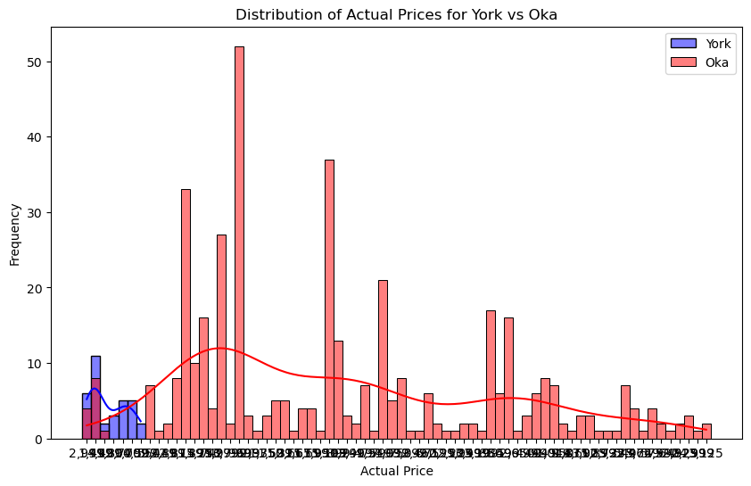
It indicates that 'Oka' products may have a wider range of actual prices or a higher frequency of occurrence within the dataset. The summary could suggest that 'Oka' products may have a broader appeal or a larger market presence compared to 'York' products in terms of price distribution.

Slide 11
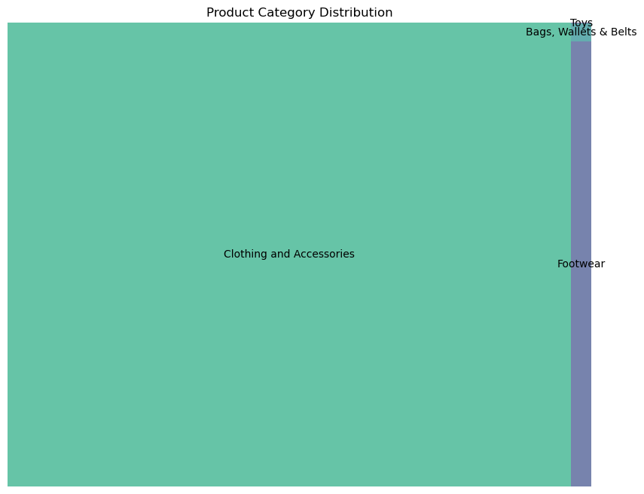
The treemap visualization effectively communicates the distribution of product categories in the dataset, highlighting the dominance of "Clothing and Accessories" followed by "Footwear," "Bags, Wallets & Belts," and "Toys" in descending order of prevalence.

Slide 12
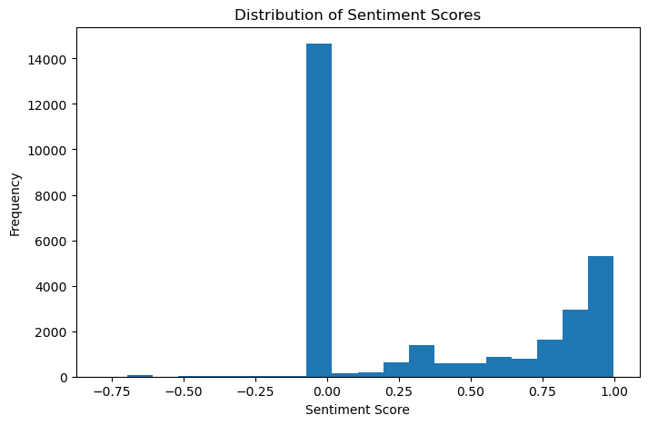
The histogram of sentiment scores shows the distribution of sentiment polarity across the product descriptions. If the sentiment score ranges from 0.00 to 1.00, it indicates a positive sentiment. Therefore, the summary would emphasize that the majority of product descriptions in the dataset convey positive sentiment.

Slide 13
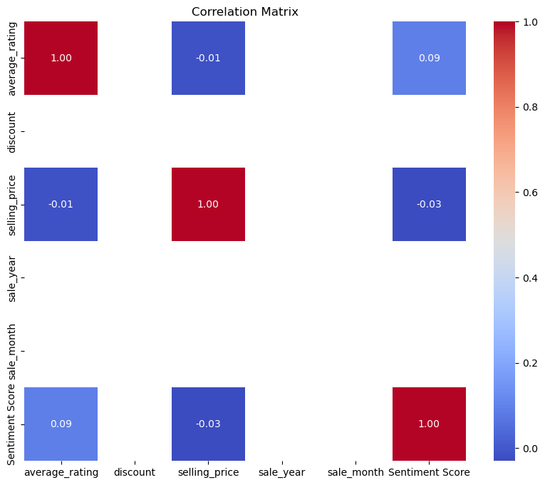
The heatmap visualization allows for a quick and intuitive understanding of the relationships between numerical features in the dataset. Strong positive correlations are indicated by warmer colors, while strong negative correlations are represented by cooler colors. Features with high positive correlations may tend to increase or decrease together, while features with high negative correlations may move in opposite directions.

Slide 14
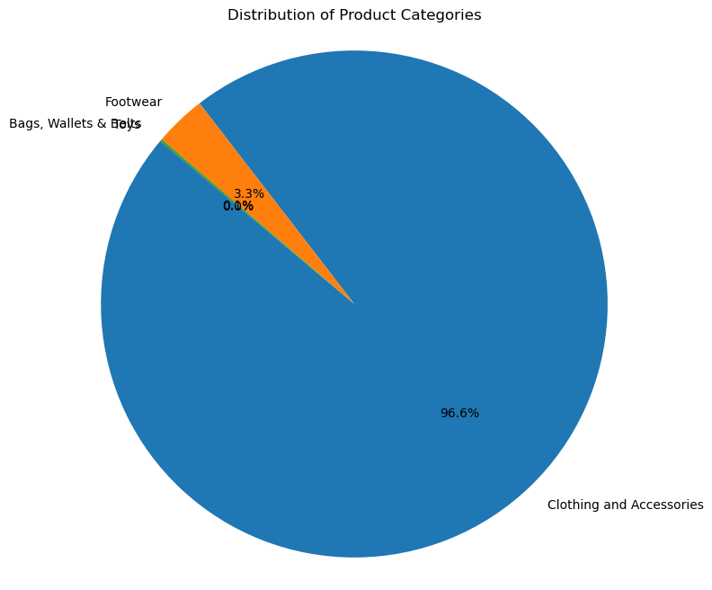
The pie chart visually represents the distribution of product categories in the dataset. Each wedge of the pie corresponds to a category, and its size represents the proportion of products in that category relative to the total. The chart provides a clear overview of the relative importance of each category in the dataset, allowing for easy comparison of category sizes.

Slide 15
4. Linear Regression Modeling
Objective: Predict selling prices based on average ratings.
Model Implementation:
Linear regression model trained on average ratings as input features and selling prices as target variable.
Evaluation of model performance using metrics such as R-squared and coefficients.

Slide 16
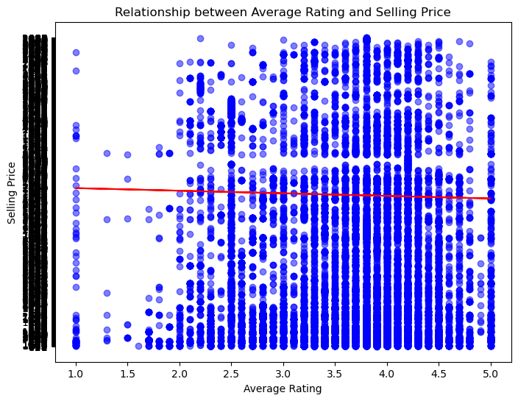
The scatter plot illustrates the relationship between average rating and selling price of products. The red line indicates the linear regression model's prediction for selling price based on average rating. This analysis provides insights into how average rating may influence the selling price of products, allowing for further exploration of pricing strategies and consumer behavior.

Slide 17
5. Conclusion
The analysis provides valuable insights into product categories, brand performance, pricing trends, and customer sentiments.
Linear regression modeling enhances understanding of the relationship between average ratings and selling prices.
These insights can inform decision-making processes for inventory management, marketing strategies, and product development.

Slide 18
Thank You

